Slide 1
NEO TRANSPORTER
ZERO GEE Bee
Your Friendly Neighborhood Drone

Slide 2
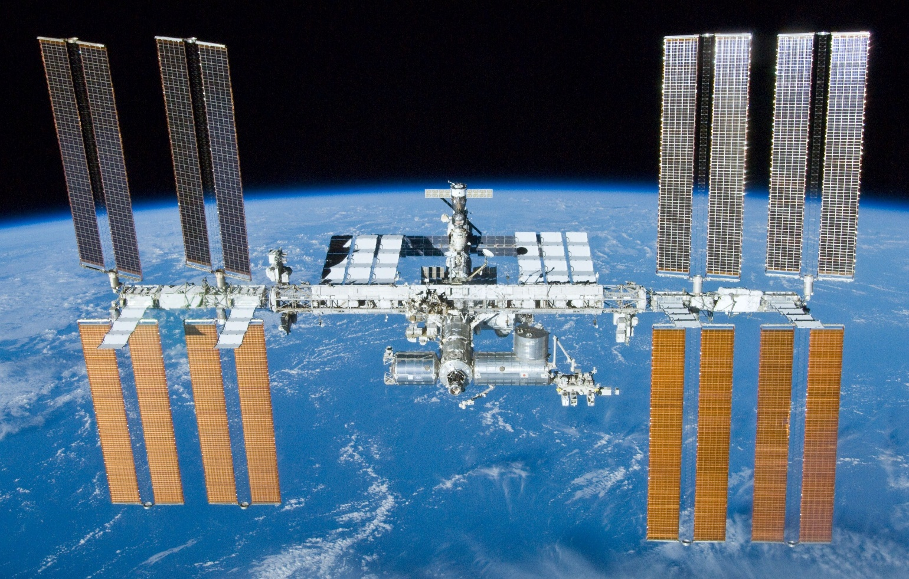
1.The problem is:
-Astronauts living in the International Space Station need help carrying goods around.

Slide 3
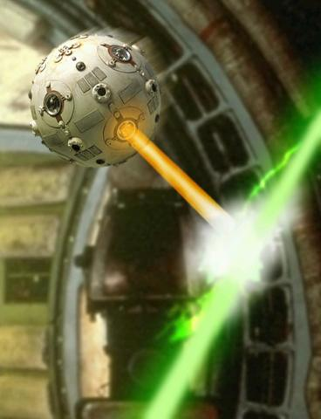
2.inspiration
-Drones
-Autonomous navigation within a human-inhabited spacecraft.
-Safety and efficiency
-Idea came from the professor David W. Miller who challenged his students to design a space vehicle similar to the light saber training droid as seen in star wars: A new hope
Similar vehicle from Star Wars (Picture 1)

Slide 4
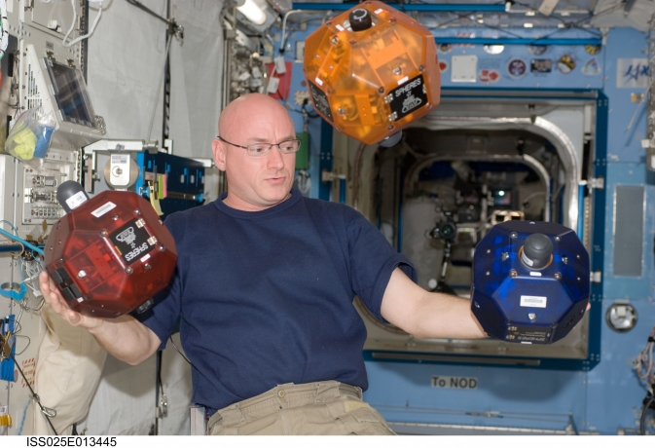
3.Original Design
SPHERES-Three flying vehicles are used inside the ISS.
-These vehicles have the size and mass of a bowling ball and use cold gas thrusters (CO2) to move.
-The vehicles also use ultrasound beacons to identify their position.
SPHERES-Three different Shell Colors(Picture 2)

Slide 5
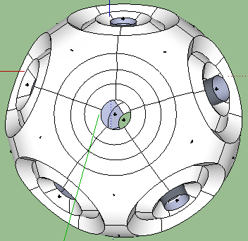
4.Our approach
-Uses a type of electrically operated propeller in a propulsion tube, just like a simple DC electromotor
-Creates airflow, through a smaller opening, higher compression.
-The robot must contain a minimum of 6 air outlet holes and 1 larger intake hole. On every of the 6 holes there is a propeller like described above. (Picture 4,5,6,7,8)
Design of the neo transporter (Picture 3)

Slide 6
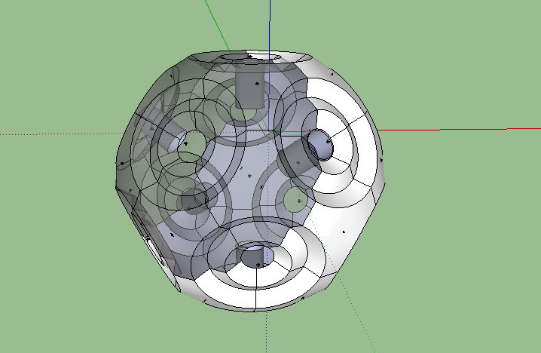
Design of the neo transporter (Picture 4)

Slide 7
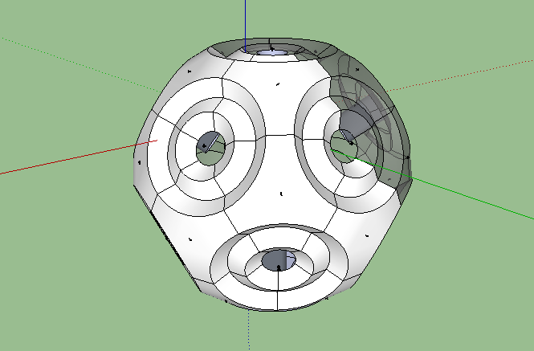
Design of the neo transporter (Picture 5)

Slide 8
5. Differences
Original Design | Our approach
Uses CO2 and O2 | Doesn’t use CO2 and O2
Increased risk of fire | No such risk
More expensive transportation and production | More economically efficient

Slide 9
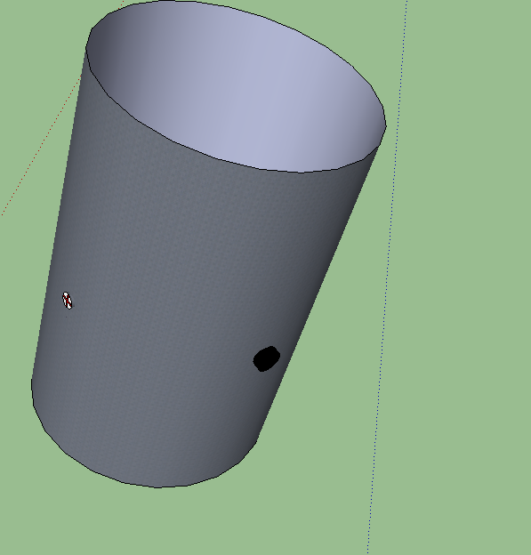
Propulsion system (Picture 6)

Slide 10
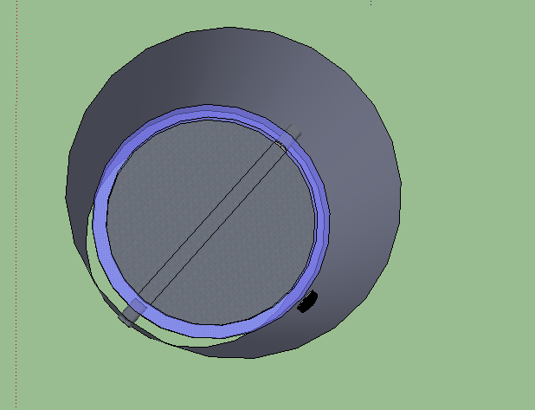
-By passing current through the coil, the magnetic field of the coil and the magnetic field of the permanent magnet interact and cause a rotational motion.
Copper coil
Air duct
Main Shaft
Permanent magnet
Parts of the propulsion system (Picture 7)

Slide 11
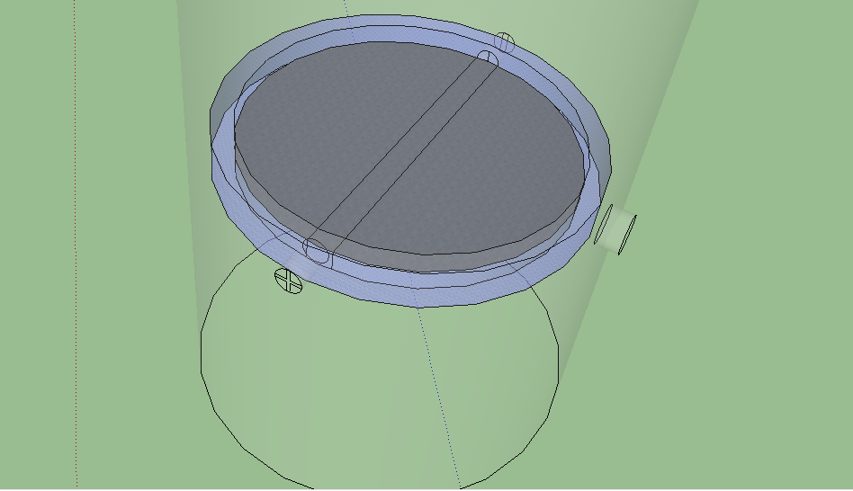
Copper coil
Main Shaft
Permanent magnet
Parts of the propulsion system (Picture 8)

Slide 12
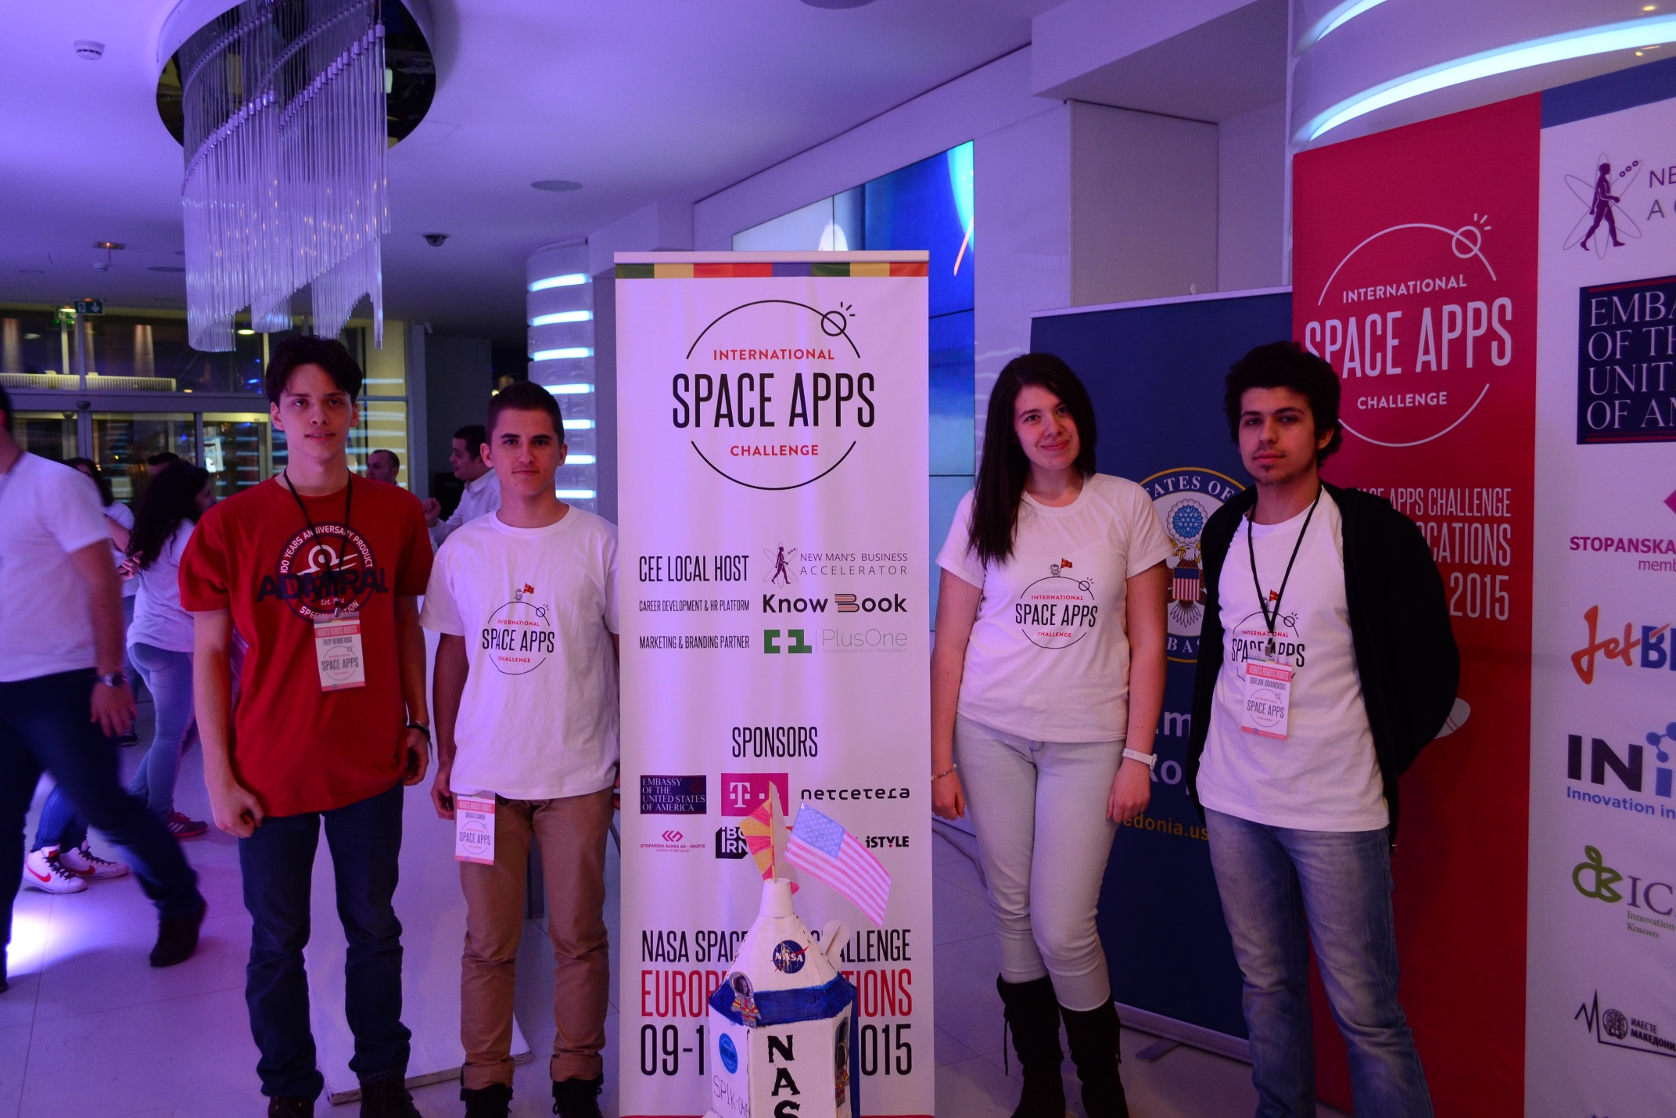
Team members: Filip Bendevski, Dragi Kamov, Angela Mitrovska, Borjan Jovanovski

